Slide 1
HIVEi Highway Information View and Extract Interface
2018-09-05 KYTC Partnering Conference
Louisville, KY

Slide 2
Started …
District Transportation Plan Map (DTPM)
2011 analysis process
Provide one place to find all the data needed
Display on map
Tabular display …
Highway Information View and Extract interface
View the layers
Extract them

Slide 3
HIVEiPublic
Maps/Resources
DataMart

Slide 4
HIVEiPublic
DataMart - http://datamart.business.transportation.ky.gov/
County Summaries
Vehicle Counts
Advanced Queries

Slide 5
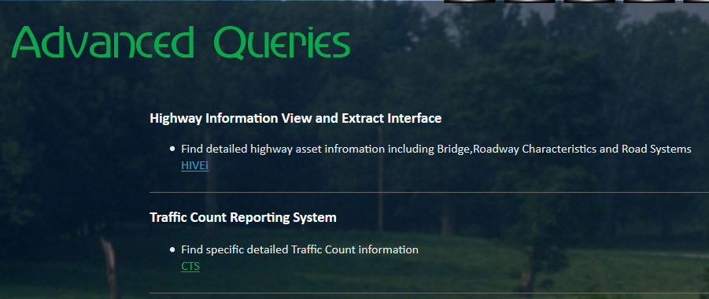
HIVEiPublic
HIVEi
CTS

Slide 6
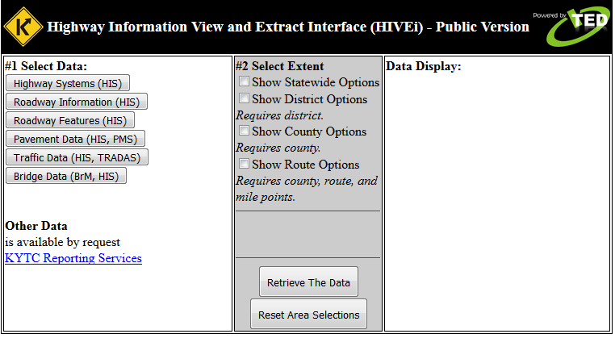
HIVEi
Take a Closer Look

Slide 7
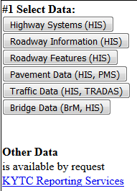
HIVEi – how it works
Select the Data to Extract
Highway Systems
Roadway Information
Roadway Features
Pavement Data
Traffic Data
Bridge Data
Other Data

Slide 8
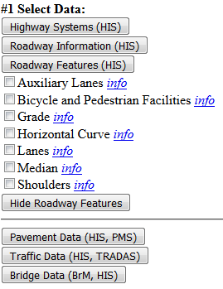
HIVEi – how it works
Select the Data to Extract
Click Header to Expand
Check Item to Query
Click Info for Details
Click Hide to Collapse

Slide 9
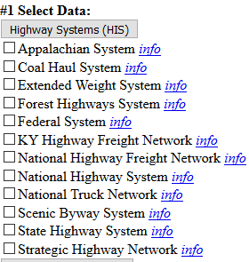
HIVEi – how it works - systems
Highway Systems
Stored together
Federal System
National Highway System
Strategic Highway Network
Info links
Asset metadata
Attribute metadata
Lookup values

Slide 10
HIVEi – how it works
Highway Systems
Appalachian System
Coal Haul System
Extended Weight System
Forest Highways System
Federal System
KY Highway Freight Network
National Highway Freight Network
National Highway System
National Truck Network
Scenic Byway System
State Highway System
Strategic Highway Network
Roadway Information
Access Control
Evaluation Sections
Posted Speed Limit
Route Log
Truck Weight Class
Type of Operation
Roadway Features
Auxiliary Lanes
Bicycle and pedestrian Facilities
Grade
Horizontal Curve
Lanes
Median
Shoulders
Pavement Data
IRI Roughness
Pavement Management
Traffic Data
Traffic Flow
Bridge Data
Bridges

Slide 11
HIVEi – how it works
Select the Extent
Statewide
District
County
Route
Beginning MP
Ending MP
Choices Cascade
District
County
Route
Based on Through Lanes

Slide 12
HIVEi – how it works
Data Display
Thumbnail Maps
Shows Finest extent
Shows 2nd Finest extent

Slide 13
HIVEi – how it works
Data Display
Extract Buttons
Shows All Checked
Shows Only Checked
CSV
Intelligent Names
Display Grid
For Route Only
Not all the Attributes
All Columns in Extracts
Fields
LRS (2 spaces)
Codes + Descriptive

Slide 14
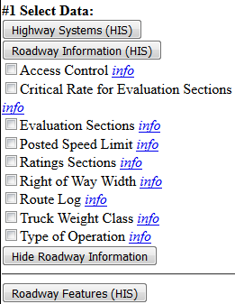
HIVEi – other flavors
HIVEiPublic
Slides Pull from up to this point
HIVEiKYTC
Adds Critical Rate for Evaluation Sections
Adds Right of Way Width

Slide 15
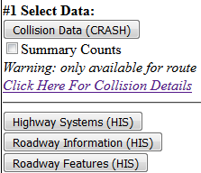
HIVEi – other flavors
HIVEiSecure
Adds Collision Data
Summary Counts for Collisions
Using KABCO Scale
Detail Query Page
View Collision PDF
Display GPS on Map

Slide 16
HIVEi
Questions?
Email:
Ed.Harding@ky.gov

